Slide 1
Dealing with your Digital ‘Stuff’: a personal journey exploring this space
Steven M. Drucker
Principal Researcher
Microsoft Research

Slide 2
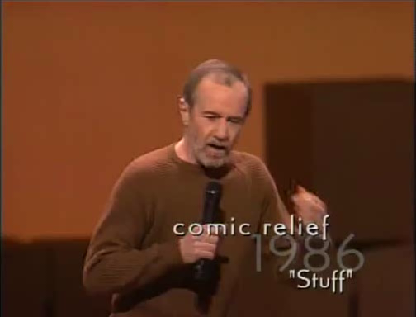
Intro:
George Carlin: We’ve got lots of ‘stuff’

Slide 3
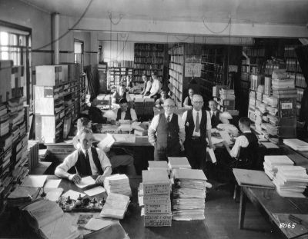
Introduction: Information Overload

Slide 4
Introduction: Information Overload
Opportunity
Digital storage and communications makes an unprecedented amount of material available to people today.
Email, photos, music, web pages, documents, presentations
2 Billion videos watched per day on YouTube (2010)
36 Billion photos uploaded to FaceBook Annually (2010)
107 Terabytes of emails sent annually
Digital Images, Web pages increasing exponentially
Notes:
Need to fill in numbers for digital images and web pages

Slide 5
Design Inspiration
The depiction of information using spatial or graphical representations, to facilitate comparison, pattern recognition, change detection, and other cognitive skills by making use of the visual system.
Marti Hearst

Slide 6
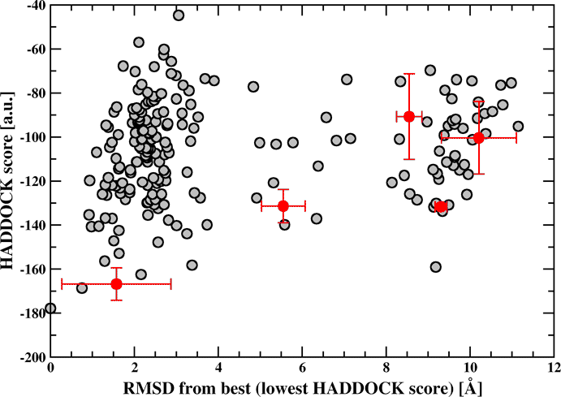
Design Inspiration
Information Visualization Techniques
Extract salient features
Use spatial layout
For analytics, but what about for guiding us in the creation of new interfaces

Slide 7
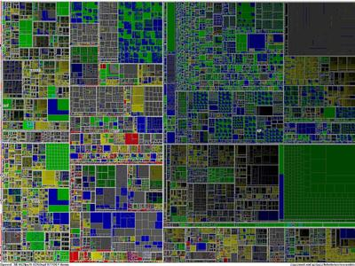
Design Inspiration
Information Visualization Techniques
Rely on visual processing system

Slide 8
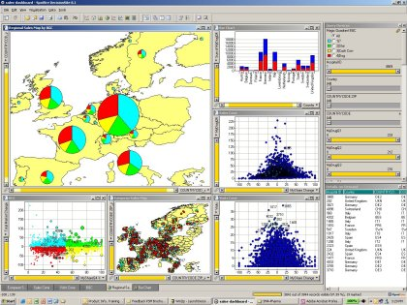
Design Inspiration
Link visualizations where appropriate

Slide 9
Design Iteration
Sketches
Storyboards
Videos
Prototypes
Evaluation
Novel Experiences
Cull
Evaluate
Pick
Iterative Design
Adapted from Bill Buxton: www.billbuxton.com

Slide 10
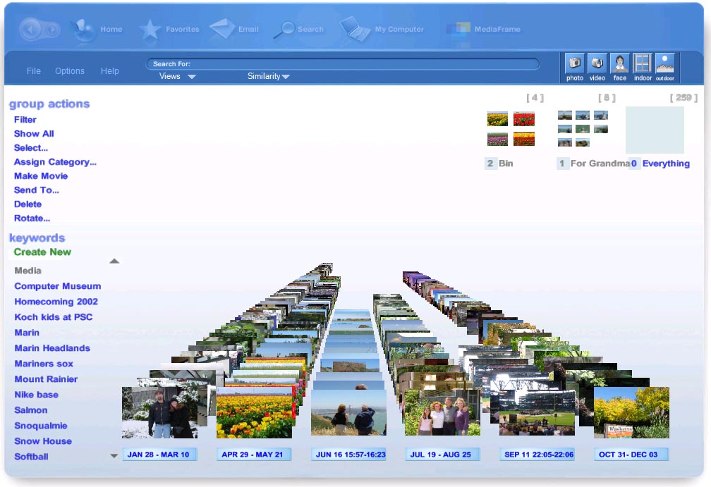
MediaFrame Demo
Drucker, S. C. Wong, A. Roseway, S. Glenner, S. De Mar, MediaBrowser: Reclaiming the Shoebox. in Proceedings of AVI2004, Gallipoli, Italy, 2004.
Notes:
Where it all started for me: Project that’s nearly ~9 years old.

Slide 11
Media Frame: Key Lessons:
Overview first, zoom and filter, then details-on-demand
(Shneiderman’s Visual Information Seeking Mantra)
Extract features:
Still/Video, Faces, Indoor/Outdoor, Time, Color Histogram, Vectors
Use to filter/select
Linking and Brushing
Cluster on time
Facilitate actions such as gathering, labeling

Slide 12
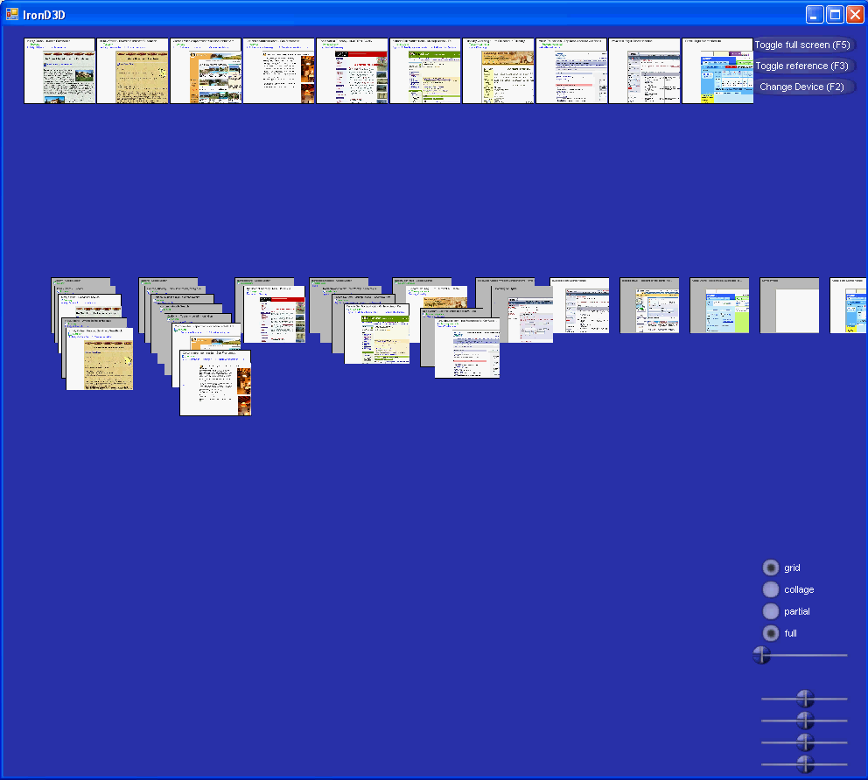
What about web browsing?
WebSpace: Mira Dontcheva, Michael Cohen, Steven Drucker, 2006
Reminiscent of Waterson et al. WebQuilt 2002
Notes:
Didn’t succeed with what we were trying to do!

Slide 13
Problems with WebSpace
Small thumbs of Web Pages indistinguishable
Not really the relevant information that we’re looking to summarize our session
This lead to 2 different research projects:
Visual Snippets
Web Summaries

Slide 14
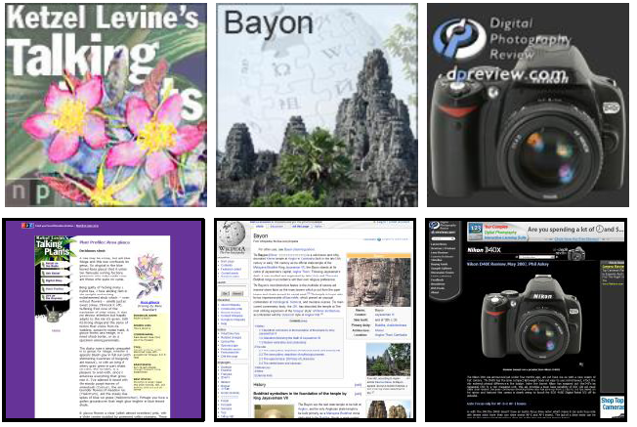
Visual Snippets
Hand design a summary of a web page
Teevan J, Cutrell E, Fisher D, Drucker SM, Ramos G, Andr�P, et al. Visual snippets: summarizing web pages for search and revisitation [Internet]. In: Proceedings of the 27th international conference on Human factors in computing systems. Boston, MA, USA: ACM; 2009 [cited 2010 Aug 10]. p. 2023-2032
Notes:
First get a designer to create summaries of a web page, then analyze and reproduce automatically

Slide 15
Visual Snippets (cont)
Identify Logo, Title, Primary Image, Differentially Scale

Slide 16
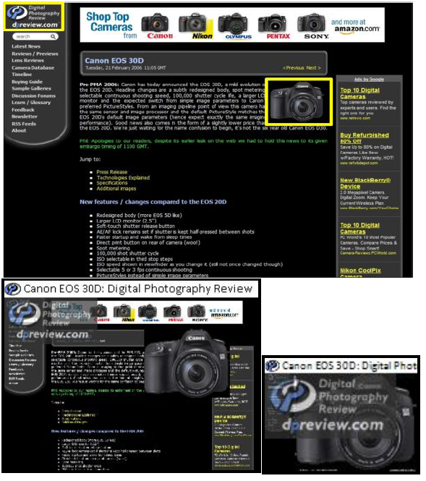
Visual Snippet (Example 1)

Slide 17
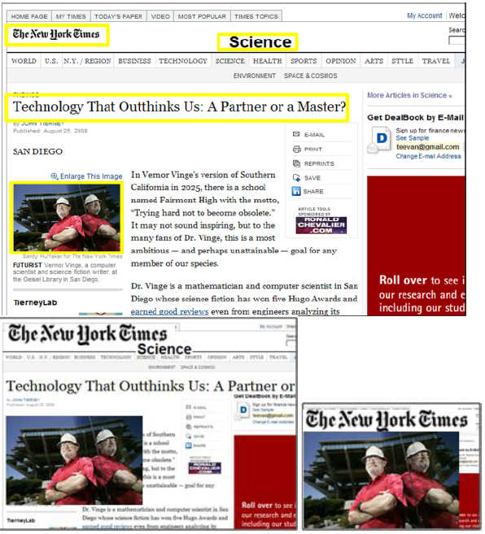
Visual Snippet (Example 1)

Slide 18
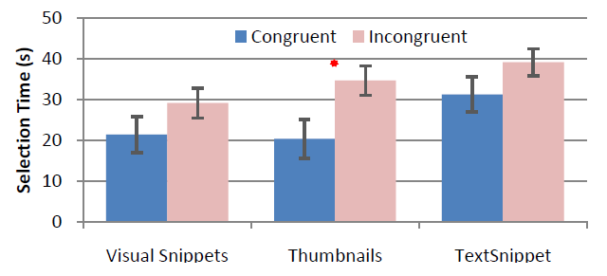
Summary of results
If you’ve seen them before (congruent), then visual snippets and thumbs are about equal (better than text snippets).
If you haven’t seen them before, snippets are sig. better than regular thumbs.

Slide 19
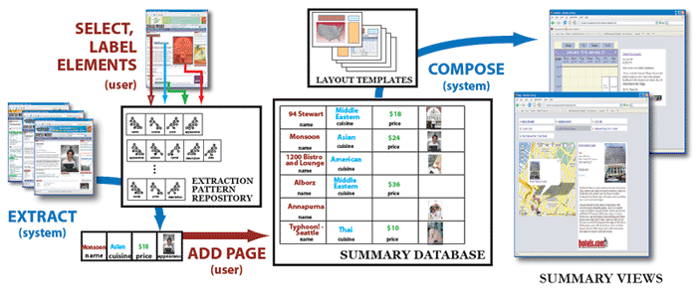
Summarizing Personal Web Browsing Sessions
Mira Dontcheva, Steven M. Drucker, Geraldine Wade, David Salesin, Michael F. Cohen. Summarizing personal web browsing sessions. ACM New York, NY, USA; UIST, 2006. p. 115-124.
Notes:
Add reference

Slide 20
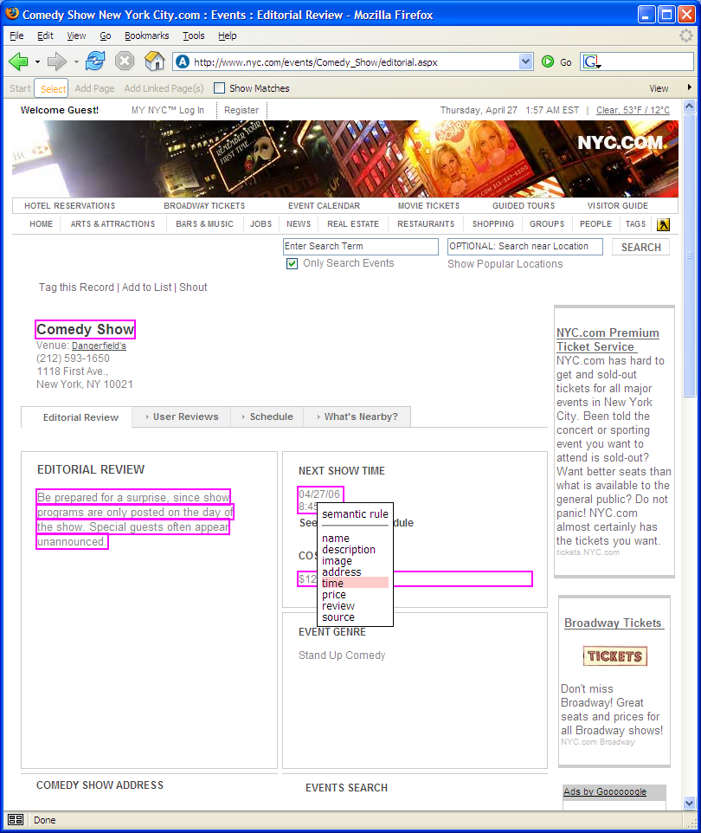
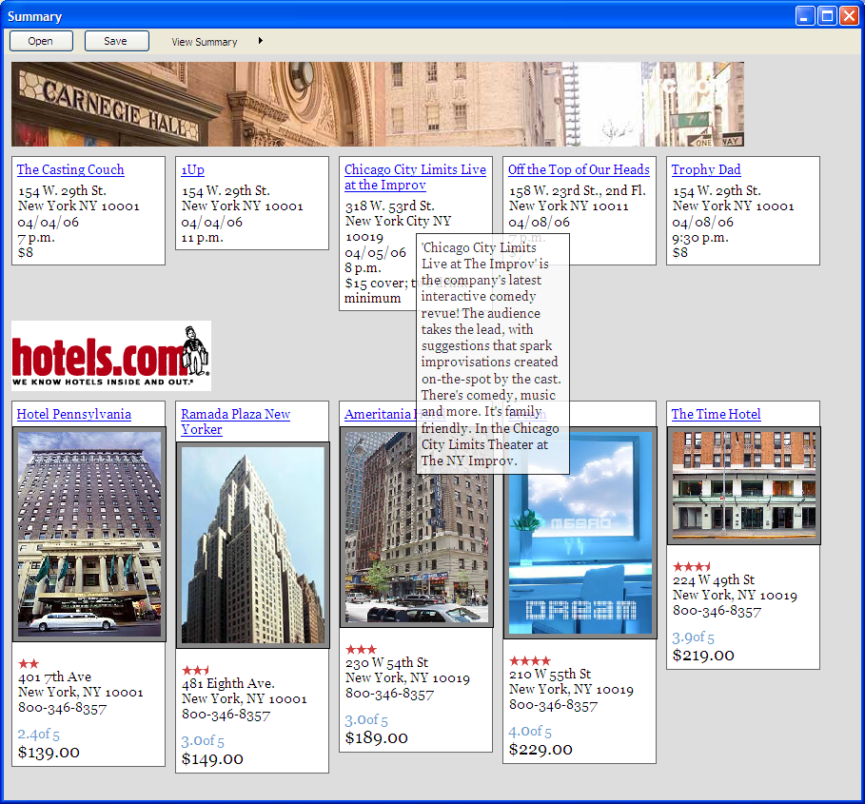
Our Approach
Notes:
Our approach comes in two steps. First we provide a semi-automatic mechanism for collecting web content. The user can specify the information he cares and and given this specification we can then automatically extract similar content. Second through the use of layout templates we create visual summaries of the content. So first let’s take a look at the extraction part. Since we are already here in Montreux and we have all already done our planning, let’s now plan next year’s UIST, which will be in Boston.

Slide 21
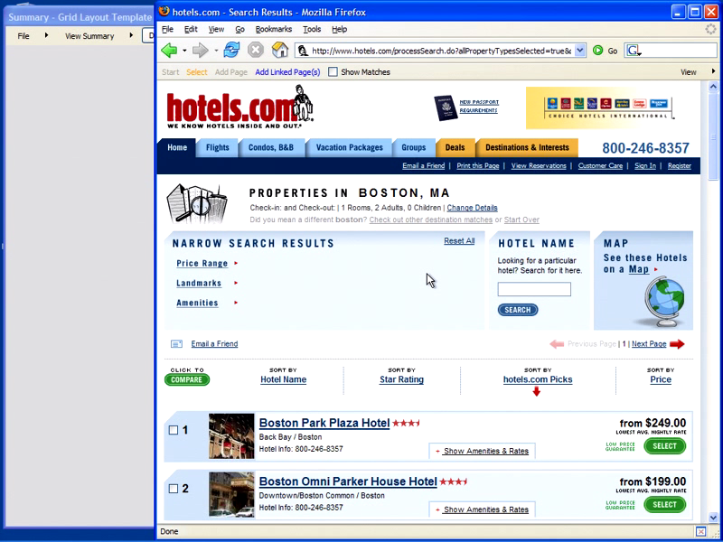
video
Notes:
So first let’s take a look at some possible hotels. First let me say that our system lives as a browser extension and is available to the user through a toolbar and this toolbar opens a window where the user can collect content. So this hotel looks good. To save this hotel I press the select button start selecting webpage elements. You notice that as I move the mouse over the webpage different webpage elements become selectable. To select a webpage element I just click and then tag the element with the appropriate label. In this way I select the name, address, image, description and price of this hotel. When I am done, I press select again and now the information is stored in my summary. Now, when I go to a new hotel page and I want to save this hotel, all I have to do is say “Add Page” and the content is automatically added to my summary. Even better, I don’t have to visit actual webpages. With the “Add Linked Pages” button, I can select any number of hyperlinks and the content from the subsequent pages will be added to my summary. The content is being displayed through the user of a layout template, which is why the description for each hotel is only available through mouse-over. I will show you more layout templates a little bit later but first let’s take a closer look at how we make this happen.
Now I know next year’s UIST is still a ways away but those of you who are planning to go, know that is in Boston, and so to make my demo a little bit more intersting
Demo
Add hotels
Add some hikes
Show that both are in the same format although from different webpages
Define terminology
Extraction patterns
Webpage element
Layout templates

Slide 22
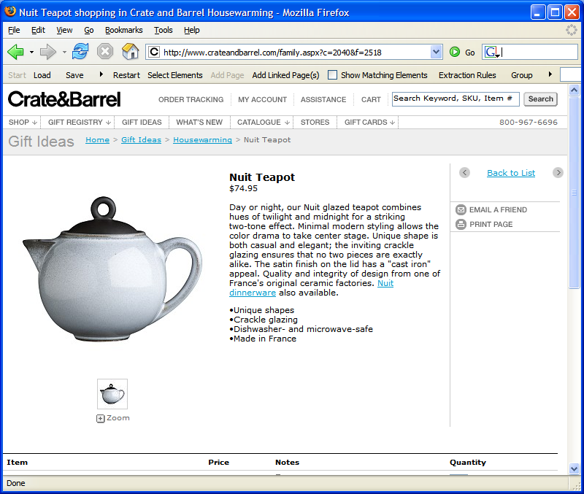
Notes:
Every webpage is represented by a tree of html nodes. And this tree can be accessed through the Document Object Model. Every node in the tree then corresponds to a selectable element in a webpage. We use this DOM structure to provide selectable elements to the user. For a given selection, we build an extraction rule that corresponds to the path from the corresponding node to the root of the tree and store the rule and corresponding page element. We build extraction rules for all selected elements and store the rules and page elements locally. The page elements are stored in a database according to the labels specified by the user. When the user goes to a new webpage, each rule is matched against the new DOM tree. If there is a match, the matching page element can be stored. If there isn’t a matching element, the rule is not used. We group the extraction rules into extraction patterns and as the user creates new patterns, we apply the pattern that matches the highest number of page elements. To compose the gathered content into a visual summary, we use layout templates. The templates are defined with respect to the labels assigned by the user. Each layout template specifies how the elements are organized, the element formatting, and a set of interactions that define how the user can interact with the summary.

Slide 23
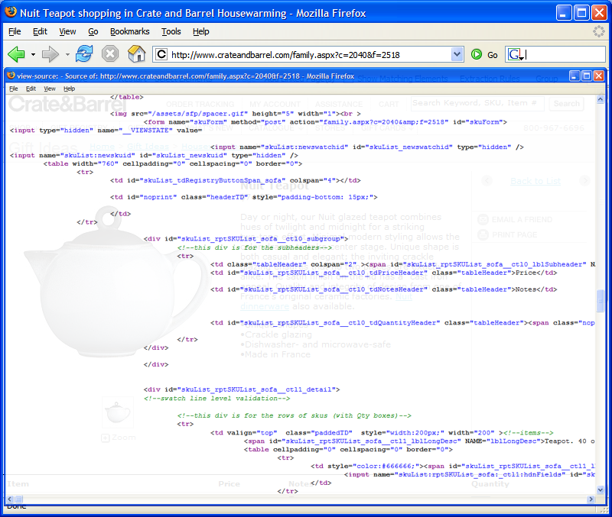
Notes:
Every webpage is represented by a tree of html nodes. And this tree can be accessed through the Document Object Model. Every element in a webpage than corresponds to a node in the tree. We use this DOM structure to provide selectable elements to the user. For a given selection, we build an extraction rule that corresponds to the path from the corresponding node to the root of the tree and store the rule and corresponding page element. We build extraction rules for all selectable elements and store the rules and page elements locally. The page elements are stored in a database according to the labels specified by the user. When the user goes to a new webpage, each rule is matched against the new DOM tree. If there is a match, the matching page element can be stored. If there isn’t a matching element, the rule is not used. We group the extraction rules into extraction patterns and as the user creates new patterns, we apply the pattern that matches the highest number of page elements. To compose the gathered content into a visual summary, we use layout templates. The templates are defined with respect to the labels assigned by the user. Each layout template specifies how the elements are organized, the element formatting, and a set of interactions that define how the user can interact with the summary.

Slide 24
Document Object Model
<html>
<body>
...
<table>
<p>
<tr>
<br>
<table>
...
<td>
<td>
<td>
<td>
<input>
<p>
<i>
<span>
<image>
Notes:
Every webpage is represented by a tree of html nodes. And this tree can be accessed through the Document Object Model. Every element in a webpage than corresponds to a node in the tree. We use this DOM structure to provide selectable elements to the user. For a given selection, we build an extraction rule that corresponds to the path from the corresponding node to the root of the tree and store the rule and corresponding page element. We build extraction rules for all selectable elements and store the rules and page elements locally. The page elements are stored in a database according to the labels specified by the user. When the user goes to a new webpage, each rule is matched against the new DOM tree. If there is a match, the matching page element can be stored. If there isn’t a matching element, the rule is not used. We group the extraction rules into extraction patterns and as the user creates new patterns, we apply the pattern that matches the highest number of page elements. To compose the gathered content into a visual summary, we use layout templates. The templates are defined with respect to the labels assigned by the user. Each layout template specifies how the elements are organized, the element formatting, and a set of interactions that define how the user can interact with the summary.

Slide 25
<html>
<head>
<body>
<br>
<table>
<table>
<tr>
<tr>
<img>
<p>
<td>
<table>
<table>
<span>
<tr>
<tr>
<tr>
<tr>
<img>
<td>
<td>
<div>
<p>
<div>
<span>
<div>
<b>
<i>
<img>
<p>
<i>
<i>
Notes:
Every webpage is represented by a tree of html nodes. And this tree can be accessed through the Document Object Model. Every element in a webpage than corresponds to a node in the tree. We use this DOM structure to provide selectable elements to the user. For a given selection, we build an extraction rule that corresponds to the path from the corresponding node to the root of the tree and store the rule and corresponding page element. We build extraction rules for all selectable elements and store the rules and page elements locally. The page elements are stored in a database according to the labels specified by the user. When the user goes to a new webpage, each rule is matched against the new DOM tree. If there is a match, the matching page element can be stored. If there isn’t a matching element, the rule is not used. We group the extraction rules into extraction patterns and as the user creates new patterns, we apply the pattern that matches the highest number of page elements. To compose the gathered content into a visual summary, we use layout templates. The templates are defined with respect to the labels assigned by the user. Each layout template specifies how the elements are organized, the element formatting, and a set of interactions that define how the user can interact with the summary.

Slide 26
<html>
<head>
<body>
<br>
<table>
<table>
<tr>
<tr>
<img>
<p>
<td>
<table>
<table>
<span>
<tr>
<tr>
<tr>
<tr>
<img>
<td>
<td>
<div>
<p>
<div>
<span>
<div>
<b>
<i>
<img>
<a>
<p>
<i>
<i>
Notes:
Every webpage is represented by a tree of html nodes. And this tree can be accessed through the Document Object Model. Every element in a webpage than corresponds to a node in the tree. We use this DOM structure to provide selectable elements to the user. For a given selection, we build an extraction rule that corresponds to the path from the corresponding node to the root of the tree and store the rule and corresponding page element. We build extraction rules for all selectable elements and store the rules and page elements locally. The page elements are stored in a database according to the labels specified by the user. When the user goes to a new webpage, each rule is matched against the new DOM tree. If there is a match, the matching page element can be stored. If there isn’t a matching element, the rule is not used. We group the extraction rules into extraction patterns and as the user creates new patterns, we apply the pattern that matches the highest number of page elements. To compose the gathered content into a visual summary, we use layout templates. The templates are defined with respect to the labels assigned by the user. Each layout template specifies how the elements are organized, the element formatting, and a set of interactions that define how the user can interact with the summary.

Slide 27
<html>
<head>
<body>
<br>
<table>
<table>
<tr>
<tr>
<img>
<p>
<td>
<table>
<table>
<span>
<tr>
<tr>
<tr>
<tr>
<img>
<td>
<td>
<div>
<p>
<div>
<span>
<div>
<b>
<i>
<img>
<a>
<p>
<i>
<i>
Notes:
Every webpage is represented by a tree of html nodes. And this tree can be accessed through the Document Object Model. Every element in a webpage than corresponds to a node in the tree. We use this DOM structure to provide selectable elements to the user. For a given selection, we build an extraction rule that corresponds to the path from the corresponding node to the root of the tree and store the rule and corresponding page element. We build extraction rules for all selectable elements and store the rules and page elements locally. The page elements are stored in a database according to the labels specified by the user. When the user goes to a new webpage, each rule is matched against the new DOM tree. If there is a match, the matching page element can be stored. If there isn’t a matching element, the rule is not used. We group the extraction rules into extraction patterns and as the user creates new patterns, we apply the pattern that matches the highest number of page elements. To compose the gathered content into a visual summary, we use layout templates. The templates are defined with respect to the labels assigned by the user. Each layout template specifies how the elements are organized, the element formatting, and a set of interactions that define how the user can interact with the summary.

Slide 28
<html>
<head>
<body>
<br>
<table>
<table>
<tr>
<tr>
<img>
<p>
<td>
<table>
<table>
<span>
<tr>
<tr>
<tr>
<tr>
<img>
<td>
<td>
<div>
<p>
<div>
<span>
<div>
<b>
<i>
<img>
<a>
<p>
<i>
<i>
Notes:
Every webpage is represented by a tree of html nodes. And this tree can be accessed through the Document Object Model. Every element in a webpage than corresponds to a node in the tree. We use this DOM structure to provide selectable elements to the user. For a given selection, we build an extraction rule that corresponds to the path from the corresponding node to the root of the tree and store the rule and corresponding page element. We build extraction rules for all selectable elements and store the rules and page elements locally. The page elements are stored in a database according to the labels specified by the user. When the user goes to a new webpage, each rule is matched against the new DOM tree. If there is a match, the matching page element can be stored. If there isn’t a matching element, the rule is not used. We group the extraction rules into extraction patterns and as the user creates new patterns, we apply the pattern that matches the highest number of page elements. To compose the gathered content into a visual summary, we use layout templates. The templates are defined with respect to the labels assigned by the user. Each layout template specifies how the elements are organized, the element formatting, and a set of interactions that define how the user can interact with the summary.

Slide 29
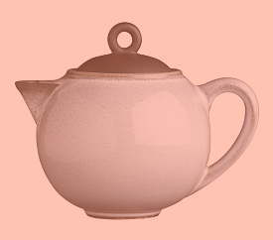
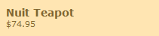
<html>
<head>
<body>
<br>
<table>
<table>
<tr>
<tr>
<img>
<p>
<td>
<table>
<table>
<span>
<tr>
<tr>
<tr>
<tr>
<img>
<td>
<td>
<div>
<p>
<div>
<span>
<div>
<b>
<i>
<img>
<a>
<p>
<i>
<i>
Notes:
Every webpage is represented by a tree of html nodes. And this tree can be accessed through the Document Object Model. Every element in a webpage than corresponds to a node in the tree. We use this DOM structure to provide selectable elements to the user. For a given selection, we build an extraction rule that corresponds to the path from the corresponding node to the root of the tree and store the rule and corresponding page element. We build extraction rules for all selectable elements and store the rules and page elements locally. The page elements are stored in a database according to the labels specified by the user. When the user goes to a new webpage, each rule is matched against the new DOM tree. If there is a match, the matching page element can be stored. If there isn’t a matching element, the rule is not used. We group the extraction rules into extraction patterns and as the user creates new patterns, we apply the pattern that matches the highest number of page elements. To compose the gathered content into a visual summary, we use layout templates. The templates are defined with respect to the labels assigned by the user. Each layout template specifies how the elements are organized, the element formatting, and a set of interactions that define how the user can interact with the summary.

Slide 30
<html>
<head>
<body>
<br>
<table>
<table>
<tr>
<tr>
<img>
<p>
<td>
<table>
<table>
<span>
<tr>
<tr>
<tr>
<tr>
<img>
<td>
<td>
<div>
<p>
<div>
<span>
<div>
<b>
<i>
<img>
<a>
<p>
<i>
<i>
Notes:
Every webpage is represented by a tree of html nodes. And this tree can be accessed through the Document Object Model. Every element in a webpage than corresponds to a node in the tree. We use this DOM structure to provide selectable elements to the user. For a given selection, we build an extraction rule that corresponds to the path from the corresponding node to the root of the tree and store the rule and corresponding page element. We build extraction rules for all selectable elements and store the rules and page elements locally. The page elements are stored in a database according to the labels specified by the user. When the user goes to a new webpage, each rule is matched against the new DOM tree. If there is a match, the matching page element can be stored. If there isn’t a matching element, the rule is not used. We group the extraction rules into extraction patterns and as the user creates new patterns, we apply the pattern that matches the highest number of page elements. To compose the gathered content into a visual summary, we use layout templates. The templates are defined with respect to the labels assigned by the user. Each layout template specifies how the elements are organized, the element formatting, and a set of interactions that define how the user can interact with the summary.

Slide 31
<html>
<head>
<body>
<br>
<table>
<table>
<tr>
<tr>
<img>
<p>
<td>
<table>
<table>
<span>
<tr>
<tr>
<tr>
<tr>
<img>
<td>
<td>
<div>
<p>
<div>
<span>
<div>
<b>
<i>
<img>
<a>
<p>
<i>
<i>
Notes:
Every webpage is represented by a tree of html nodes. And this tree can be accessed through the Document Object Model. Every element in a webpage than corresponds to a node in the tree. We use this DOM structure to provide selectable elements to the user. For a given selection, we build an extraction rule that corresponds to the path from the corresponding node to the root of the tree and store the rule and corresponding page element. We build extraction rules for all selectable elements and store the rules and page elements locally. The page elements are stored in a database according to the labels specified by the user. When the user goes to a new webpage, each rule is matched against the new DOM tree. If there is a match, the matching page element can be stored. If there isn’t a matching element, the rule is not used. We group the extraction rules into extraction patterns and as the user creates new patterns, we apply the pattern that matches the highest number of page elements. To compose the gathered content into a visual summary, we use layout templates. The templates are defined with respect to the labels assigned by the user. Each layout template specifies how the elements are organized, the element formatting, and a set of interactions that define how the user can interact with the summary.

Slide 32
<html>
<html>
<body>
<body>
<table>
<table>
<tr>
<tr>
<td>
<td>
Summary Database
Extraction Rules
Notes:
Every webpage is represented by a tree of html nodes. And this tree can be accessed through the Document Object Model. Every element in a webpage than corresponds to a node in the tree. We use this DOM structure to provide selectable elements to the user. For a given selection, we build an extraction rule that corresponds to the path from the corresponding node to the root of the tree and store the rule and corresponding page element. We build extraction rules for all selectable elements and store the rules and page elements locally. The page elements are stored in a database according to the labels specified by the user. When the user goes to a new webpage, each rule is matched against the new DOM tree. If there is a match, the matching page element can be stored. If there isn’t a matching element, the rule is not used. We group the extraction rules into extraction patterns and as the user creates new patterns, we apply the pattern that matches the highest number of page elements. To compose the gathered content into a visual summary, we use layout templates. The templates are defined with respect to the labels assigned by the user. Each layout template specifies how the elements are organized, the element formatting, and a set of interactions that define how the user can interact with the summary.

Slide 33

<html>
<head>
<body>
<br>
<table>
<table>
<tr>
<tr>
<img>
<p>
<td>
<table>
<table>
<span>
<tr>
<tr>
<tr>
<tr>
<img>
<td>
<td>
<div>
Summary Database
<p>
<div>
<span>
<div>
<b>
<i>
<img>
<a>
<p>
<i>
<i>
Extraction Rules
<html>
<body>
<table>
<tr>
<td>
Notes:
Every webpage is represented by a tree of html nodes. And this tree can be accessed through the Document Object Model. Every element in a webpage than corresponds to a node in the tree. We use this DOM structure to provide selectable elements to the user. For a given selection, we build an extraction rule that corresponds to the path from the corresponding node to the root of the tree and store the rule and corresponding page element. We build extraction rules for all selectable elements and store the rules and page elements locally. The page elements are stored in a database according to the labels specified by the user. When the user goes to a new webpage, each rule is matched against the new DOM tree. If there is a match, the matching page element can be stored. If there isn’t a matching element, the rule is not used. We group the extraction rules into extraction patterns and as the user creates new patterns, we apply the pattern that matches the highest number of page elements. To compose the gathered content into a visual summary, we use layout templates. The templates are defined with respect to the labels assigned by the user. Each layout template specifies how the elements are organized, the element formatting, and a set of interactions that define how the user can interact with the summary.

Slide 34
<html>
<html>
<body>
<body>
<table>
<table>
<tr>
<tr>
<table>
<table>
<tr>
<tr>
<img>
<img>
Summary Database
Extraction Rules
<html>
<body>
<table>
<tr>
<td>
Notes:
Every webpage is represented by a tree of html nodes. And this tree can be accessed through the Document Object Model. Every element in a webpage than corresponds to a node in the tree. We use this DOM structure to provide selectable elements to the user. For a given selection, we build an extraction rule that corresponds to the path from the corresponding node to the root of the tree and store the rule and corresponding page element. We build extraction rules for all selectable elements and store the rules and page elements locally. The page elements are stored in a database according to the labels specified by the user. When the user goes to a new webpage, each rule is matched against the new DOM tree. If there is a match, the matching page element can be stored. If there isn’t a matching element, the rule is not used. We group the extraction rules into extraction patterns and as the user creates new patterns, we apply the pattern that matches the highest number of page elements. To compose the gathered content into a visual summary, we use layout templates. The templates are defined with respect to the labels assigned by the user. Each layout template specifies how the elements are organized, the element formatting, and a set of interactions that define how the user can interact with the summary.

Slide 35
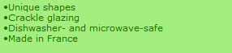
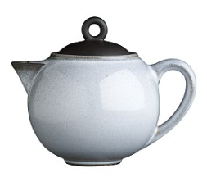
<html>
<head>
<body>
<br>
<table>
<table>
<tr>
<tr>
<img>
<p>
<td>
<table>
<table>
<span>
<tr>
<tr>
<tr>
<tr>
<img>
<td>
<td>
<div>
Summary Database
<p>
<div>
<span>
<div>
<b>
<i>
<img>
<a>
<p>
<i>
<i>
Extraction Rules
<html>
<html>
<body>
<body>
<table>
<table>
<tr>
<tr>
<table>
<td>
<tr>
<img>
Notes:
Every webpage is represented by a tree of html nodes. And this tree can be accessed through the Document Object Model. Every element in a webpage than corresponds to a node in the tree. We use this DOM structure to provide selectable elements to the user. For a given selection, we build an extraction rule that corresponds to the path from the corresponding node to the root of the tree and store the rule and corresponding page element. We build extraction rules for all selectable elements and store the rules and page elements locally. The page elements are stored in a database according to the labels specified by the user. When the user goes to a new webpage, each rule is matched against the new DOM tree. If there is a match, the matching page element can be stored. If there isn’t a matching element, the rule is not used. We group the extraction rules into extraction patterns and as the user creates new patterns, we apply the pattern that matches the highest number of page elements. To compose the gathered content into a visual summary, we use layout templates. The templates are defined with respect to the labels assigned by the user. Each layout template specifies how the elements are organized, the element formatting, and a set of interactions that define how the user can interact with the summary.

Slide 36
<html>
<html>
<body>
<body>
<table>
<table>
<tr>
<tr>
<table>
<table>
<tr>
<tr>
<div>
<div>
Summary Database
<div>
<div>
Extraction Rules
<html>
<html>
<body>
<body>
<table>
<table>
<tr>
<tr>
<table>
<td>
<tr>
<img>
Notes:
Every webpage is represented by a tree of html nodes. And this tree can be accessed through the Document Object Model. Every element in a webpage than corresponds to a node in the tree. We use this DOM structure to provide selectable elements to the user. For a given selection, we build an extraction rule that corresponds to the path from the corresponding node to the root of the tree and store the rule and corresponding page element. We build extraction rules for all selectable elements and store the rules and page elements locally. The page elements are stored in a database according to the labels specified by the user. When the user goes to a new webpage, each rule is matched against the new DOM tree. If there is a match, the matching page element can be stored. If there isn’t a matching element, the rule is not used. We group the extraction rules into extraction patterns and as the user creates new patterns, we apply the pattern that matches the highest number of page elements. To compose the gathered content into a visual summary, we use layout templates. The templates are defined with respect to the labels assigned by the user. Each layout template specifies how the elements are organized, the element formatting, and a set of interactions that define how the user can interact with the summary.

Slide 37
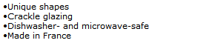
<html>
<head>
<body>
<br>
<table>
<table>
<tr>
<tr>
<img>
<p>
<td>
<table>
<table>
<span>
<tr>
<tr>
<tr>
<tr>
<img>
<td>
<td>
<div>
Summary Database
<p>
<div>
<span>
<div>
name
picture
details
<b>
<i>
<img>
<a>
<p>
<i>
<i>
Extraction Rules
<html>
<html>
<html>
<body>
<body>
<body>
<table>
<table>
<table>
<tr>
<tr>
<tr>
<table>
<table>
<td>
<tr>
<tr>
<img>
<div>
<div>
Notes:
Every webpage is represented by a tree of html nodes. And this tree can be accessed through the Document Object Model. Every element in a webpage than corresponds to a node in the tree. We use this DOM structure to provide selectable elements to the user. For a given selection, we build an extraction rule that corresponds to the path from the corresponding node to the root of the tree and store the rule and corresponding page element. We build extraction rules for all selectable elements and store the rules and page elements locally. The page elements are stored in a database according to the labels specified by the user. When the user goes to a new webpage, each rule is matched against the new DOM tree. If there is a match, the matching page element can be stored. If there isn’t a matching element, the rule is not used. We group the extraction rules into extraction patterns and as the user creates new patterns, we apply the pattern that matches the highest number of page elements. To compose the gathered content into a visual summary, we use layout templates. The templates are defined with respect to the labels assigned by the user. Each layout template specifies how the elements are organized, the element formatting, and a set of interactions that define how the user can interact with the summary.

Slide 38
Summary Database
name
picture
details
Extraction Rules
<html>
<html>
<html>
<body>
<body>
<body>
<table>
<table>
<table>
<tr>
<tr>
<tr>
<table>
<table>
<td>
<tr>
<tr>
<img>
<div>
<div>
Notes:
Every webpage is represented by a tree of html nodes. And this tree can be accessed through the Document Object Model. Every element in a webpage than corresponds to a node in the tree. We use this DOM structure to provide selectable elements to the user. For a given selection, we build an extraction rule that corresponds to the path from the corresponding node to the root of the tree and store the rule and corresponding page element. We build extraction rules for all selected elements and store the rules and page elements locally. The page elements are stored in a database according to the labels specified by the user. When the user goes to a new webpage, each rule is matched against the new DOM tree. If there is a match, the matching page element can be stored. If there isn’t a matching element, the rule is not used. We group the extraction rules into extraction patterns and as the user creates new patterns, we apply the pattern that matches the highest number of page elements. To compose the gathered content into a visual summary, we use layout templates. The templates are defined with respect to the labels assigned by the user. Each layout template specifies how the elements are organized, the element formatting, and a set of interactions that define how the user can interact with the summary.

Slide 39
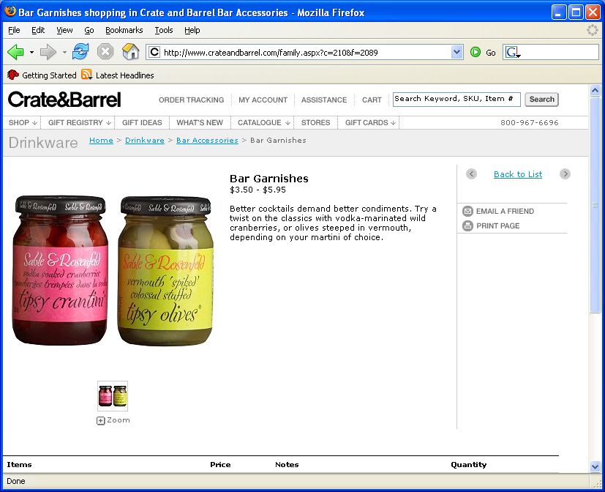
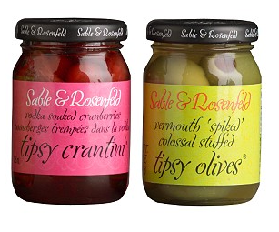

<html>
<head>
<body>
<br>
<table>
<table>
<tr>
<tr>
<img>
<p>
<td>
<table>
<table>
<span>
<tr>
<tr>
<tr>
<tr>
<img>
<td>
<td>
Summary Database
<p>
<div>
<span>
name
picture
details
<b>
<i>
<img>
<a>
Extraction Rules
<html>
<html>
<html>
<body>
<body>
<body>
<table>
<table>
<table>
<tr>
<tr>
<tr>
<table>
<table>
<td>
<tr>
<tr>
<img>
<div>
<div>
Notes:
Every webpage is represented by a tree of html nodes. And this tree can be accessed through the Document Object Model. Every element in a webpage than corresponds to a node in the tree. We use this DOM structure to provide selectable elements to the user. For a given selection, we build an extraction rule that corresponds to the path from the corresponding node to the root of the tree and store the rule and corresponding page element. We build extraction rules for all selectable elements and store the rules and page elements locally. The page elements are stored in a database according to the labels specified by the user. When the user goes to a new webpage, each rule is matched against the new DOM tree. If there is a match, the matching page element can be stored. If there isn’t a matching element, the rule is not used. We group the extraction rules into extraction patterns and as the user creates new patterns, we apply the pattern that matches the highest number of page elements. To compose the gathered content into a visual summary, we use layout templates. The templates are defined with respect to the labels assigned by the user. Each layout template specifies how the elements are organized, the element formatting, and a set of interactions that define how the user can interact with the summary.

Slide 40
<html>
<head>
<body>
<br>
<table>
<table>
<tr>
<tr>
<img>
<p>
<td>
<table>
<table>
<span>
<tr>
<tr>
<tr>
<tr>
<img>
<td>
<td>
Summary Database
<p>
<div>
<span>
name
picture
details
<b>
<i>
<img>
<a>
Extraction Rules
<html>
<html>
<html>
<html>
<body>
<body>
<body>
<body>
<table>
<table>
<table>
<tr>
<table>
<tr>
<tr>
<table>
<table>
<tr>
<tr>
<td>
<tr>
<td>
<div>
<img>
<div>
Notes:
Every webpage is represented by a tree of html nodes. And this tree can be accessed through the Document Object Model. Every element in a webpage than corresponds to a node in the tree. We use this DOM structure to provide selectable elements to the user. For a given selection, we build an extraction rule that corresponds to the path from the corresponding node to the root of the tree and store the rule and corresponding page element. We build extraction rules for all selectable elements and store the rules and page elements locally. The page elements are stored in a database according to the labels specified by the user. When the user goes to a new webpage, each rule is matched against the new DOM tree. If there is a match, the matching page element can be stored. If there isn’t a matching element, the rule is not used. We group the extraction rules into extraction patterns and as the user creates new patterns, we apply the pattern that matches the highest number of page elements. To compose the gathered content into a visual summary, we use layout templates. The templates are defined with respect to the labels assigned by the user. Each layout template specifies how the elements are organized, the element formatting, and a set of interactions that define how the user can interact with the summary.

Slide 41

<html>
<head>
<body>
<br>
<table>
<table>
<tr>
<tr>
<img>
<p>
<td>
<table>
<table>
<span>
<tr>
<tr>
<tr>
<tr>
<img>
<td>
<td>
Summary Database
<p>
<div>
<span>
name
picture
details
<b>
<i>
<img>
<a>
Extraction Rules
<html>
<html>
<html>
<html>
<body>
<body>
<body>
<body>
<table>
<table>
<table>
<table>
<tr>
<tr>
<tr>
<table>
<table>
<tr>
<table>
<tr>
<tr>
<td>
<tr>
<div>
<img>
<img>
<div>

Slide 42
<html>
<head>
<body>
<br>
<table>
<table>
<tr>
<tr>
<img>
<p>
<td>
<table>
<table>
<span>
<tr>
<tr>
<tr>
<tr>
<img>
<td>
<td>
Summary Database
<p>
<div>
<span>
name
picture
details
<b>
<i>
<img>
<a>
Extraction Rules
<html>
<html>
<html>
<html>
<body>
<body>
<body>
<body>
<table>
<table>
<table>
<tr>
<table>
<tr>
<tr>
<table>
<tr>
<table>
<table>
<tr>
<td>
<tr>
<tr>
<div>
<img>
<div>
<div>
<div>
Notes:
Every webpage is represented by a tree of html nodes. And this tree can be accessed through the Document Object Model. Every element in a webpage than corresponds to a node in the tree. We use this DOM structure to provide selectable elements to the user. For a given selection, we build an extraction rule that corresponds to the path from the corresponding node to the root of the tree and store the rule and corresponding page element. We build extraction rules for all selectable elements and store the rules and page elements locally. The page elements are stored in a database according to the labels specified by the user. When the user goes to a new webpage, each rule is matched against the new DOM tree. If there is a match, the matching page element can be stored. If there isn’t a matching element, the rule is not used. We group the extraction rules into extraction patterns and as the user creates new patterns, we apply the pattern that matches the highest number of page elements. To compose the gathered content into a visual summary, we use layout templates. The templates are defined with respect to the labels assigned by the user. Each layout template specifies how the elements are organized, the element formatting, and a set of interactions that define how the user can interact with the summary.

Slide 43
<html>
<head>
<body>
<br>
<table>
<table>
<tr>
<tr>
<img>
<p>
<td>
<table>
<table>
<span>
<tr>
<tr>
<tr>
<tr>
<img>
<td>
<td>
Summary Database
<p>
<div>
<span>
name
picture
details
<b>
<i>
<img>
<a>
Extraction Rules
<html>
<html>
<html>
<body>
<body>
<body>
<table>
<table>
<table>
<tr>
<tr>
<tr>
<table>
<table>
<td>
<tr>
<tr>
<img>
<div>
<div>
Notes:
Every webpage is represented by a tree of html nodes. And this tree can be accessed through the Document Object Model. Every element in a webpage than corresponds to a node in the tree. We use this DOM structure to provide selectable elements to the user. For a given selection, we build an extraction rule that corresponds to the path from the corresponding node to the root of the tree and store the rule and corresponding page element. We build extraction rules for all selectable elements and store the rules and page elements locally. The page elements are stored in a database according to the labels specified by the user. When the user goes to a new webpage, each rule is matched against the new DOM tree. If there is a match, the matching page element can be stored. If there isn’t a matching element, the rule is not used. We group the extraction rules into extraction patterns and as the user creates new patterns, we apply the pattern that matches the highest number of page elements. To compose the gathered content into a visual summary, we use layout templates. The templates are defined with respect to the labels assigned by the user. Each layout template specifies how the elements are organized, the element formatting, and a set of interactions that define how the user can interact with the summary.

Slide 44

Extraction Patterns
<html>
<tr>
<table>
<body>
<table>
<tr>
<table>
<tr>
<table>
<td>
<tr>
<p>
<p>
<b>
<html>
<html>
<body>
<body>
Summary Database
<table>
<tr>
<table>
name
picture
details
<table>
<p>
<tr>
<img>
<span>
.
.
.
<html>
<html>
<html>
<body>
<body>
<body>
<table>
<table>
<table>
<tr>
<tr>
<tr>
<table>
<table>
<td>
<tr>
<tr>
<img>
<div>
<div>
Notes:
Every webpage is represented by a tree of html nodes. And this tree can be accessed through the Document Object Model. Every element in a webpage than corresponds to a node in the tree. We use this DOM structure to provide selectable elements to the user. For a given selection, we build an extraction rule that corresponds to the path from the corresponding node to the root of the tree and store the rule and corresponding page element. We build extraction rules for all selectable elements and store the rules and page elements locally. The page elements are stored in a database according to the labels specified by the user. When the user goes to a new webpage, each rule is matched against the new DOM tree. If there is a match, the matching page element can be stored. If there isn’t a matching element, the rule is not used. We group the extraction rules into extraction patterns and as the user creates new patterns, we apply the pattern that matches the highest number of page elements. To compose the gathered content into a visual summary, we use layout templates. The templates are defined with respect to the labels assigned by the user. Each layout template specifies how the elements are organized, the element formatting, and a set of interactions that define how the user can interact with the summary.

Slide 45
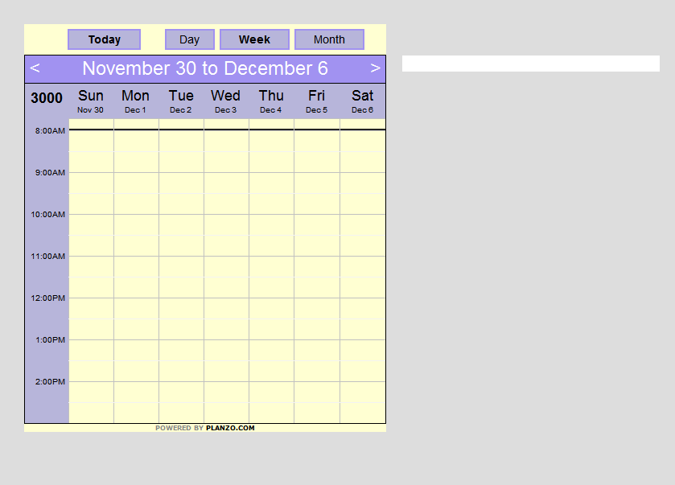
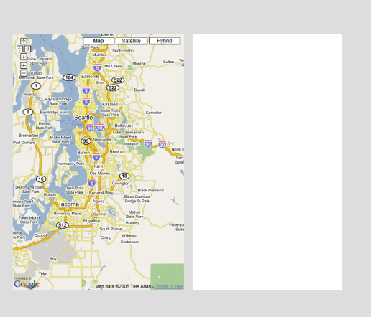
Layout Templates
Summary Database
name
picture
details
Notes:
Every webpage is represented by a tree of html nodes. And this tree can be accessed through the Document Object Model. Every element in a webpage than corresponds to a node in the tree. We use this DOM structure to provide selectable elements to the user. For a given selection, we build an extraction rule that corresponds to the path from the corresponding node to the root of the tree and store the rule and corresponding page element. We build extraction rules for all selectable elements and store the rules and page elements locally. The page elements are stored in a database according to the labels specified by the user. When the user goes to a new webpage, each rule is matched against the new DOM tree. If there is a match, the matching page element can be stored. If there isn’t a matching element, the rule is not used. We group the extraction rules into extraction patterns and as the user creates new patterns, we apply the pattern that matches the highest number of page elements. To compose the gathered content into a visual summary, we use layout templates. The templates are defined with respect to the labels assigned by the user. Each layout template specifies how the elements are organized, the element formatting, and a set of interactions that define how the user can interact with the summary.

Slide 46
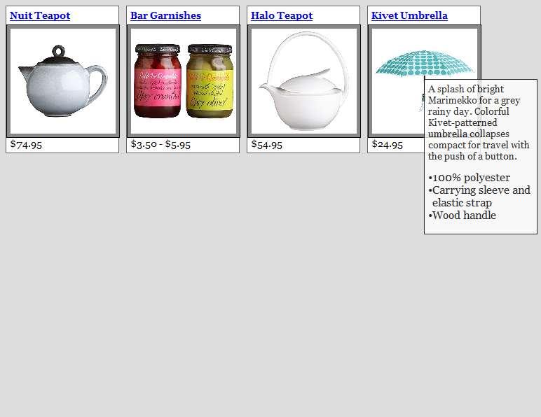
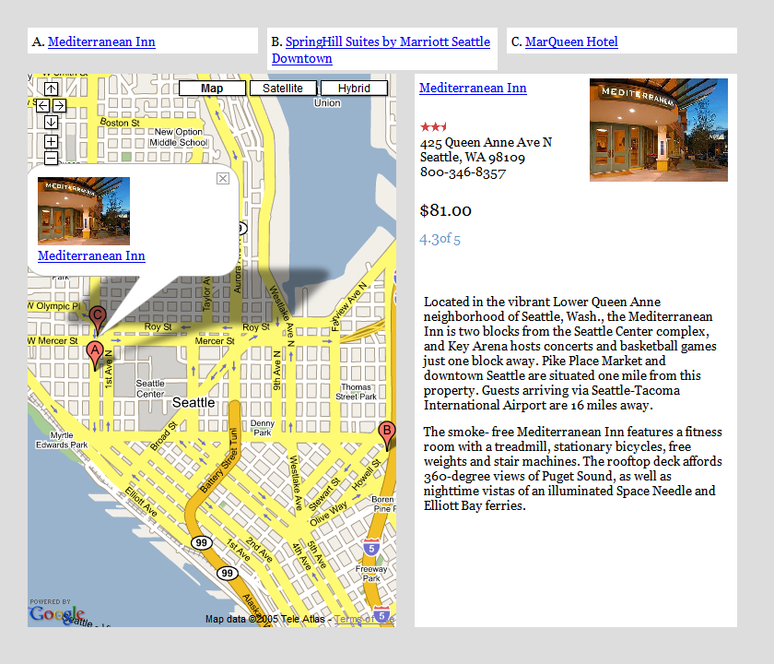
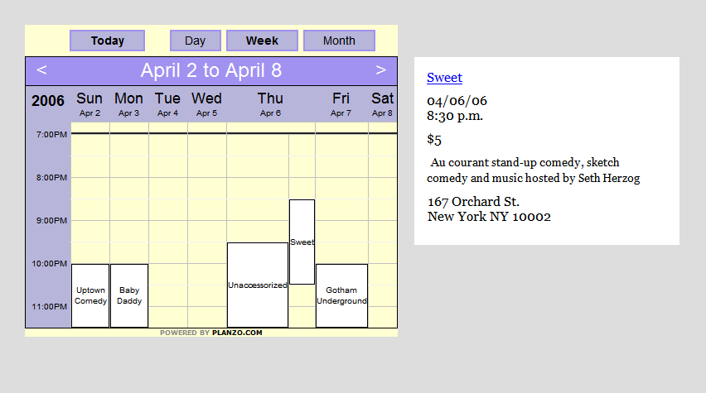

Layout Templates
Summary Database
name
picture
details
Notes:
Every webpage is represented by a tree of html nodes. And this tree can be accessed through the Document Object Model. Every element in a webpage than corresponds to a node in the tree. We use this DOM structure to provide selectable elements to the user. For a given selection, we build an extraction rule that corresponds to the path from the corresponding node to the root of the tree and store the rule and corresponding page element. We build extraction rules for all selectable elements and store the rules and page elements locally. The page elements are stored in a database according to the labels specified by the user. When the user goes to a new webpage, each rule is matched against the new DOM tree. If there is a match, the matching page element can be stored. If there isn’t a matching element, the rule is not used. We group the extraction rules into extraction patterns and as the user creates new patterns, we apply the pattern that matches the highest number of page elements. To compose the gathered content into a visual summary, we use layout templates. The templates are defined with respect to the labels assigned by the user. Each layout template specifies how the elements are organized, the element formatting, and a set of interactions that define how the user can interact with the summary.
So let’s continue our planning and take a look at some of these templates in action.

Slide 47
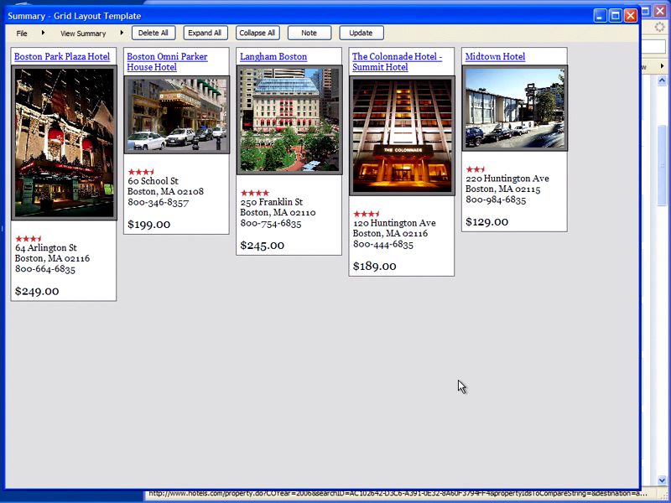
video2
Notes:
So here is where we left off. We had collected some hotels and we were using the grid layout template to view them. Since the hotels have addresses we can also view them on the map layout templates. The map template includes an interactive map and a list of the hotels at the top. As the user clicks on the list, they see detailed view to the right of the map. Now in addition to booking hotel, I often like to see if anything is happening at the city and if there are any fun events. So now let’s go to upcoming.org and collect some events. This wine tasting looks good. I can automatically add it because I have been to this website before and all the patterns are stored locally on my machine. Unfortunately this event is rather far from boston so let’s see if anything else is going on. This one looks good. And it’s much closer to the hotels. Now since we have collected some events we can use the calendar layout template to see if they are happening at the same time. This template only shows items that have a date and time. When I move the mouse over the event, a short summary is displayed, and when I click I see all the details. I should say that we maintain all the hyperlinks and I can click and access the webpages for these different DJs. Layout templates can also be defined for different devices, such as a PDA. The collection is then organized into tabs and each tab includes a list. To get more details I click on an item in the list. If you don’t have a PDA, then you can format your summary as a paper print out and take with you. So in coclusion we have created a framework that allows us to automatically organize the information for the user through the use of layout templates that display content from different sources uniformly.
Demo
the summaries are just another webpage - you can save them and open them later or send them to a friend or colleague.
I’m going to now open another summary so I can show you the map and calendar layout templates
- show calendar and map
talk about them being hyperlinked
Say that for now is static but could be dynamic

Slide 48
Conclusions: Web Summaries
Interactively specify features to extract
Then, automatically extract those features from other pages.
Use manually designed templates to re-layout, filter, sort information (using semantic information – like date, location, when possible).

Slide 49
Generalize to Other Domains?
Let’s look at personal document collections
http://research.microsoft.com/~sdrucker/
Overview first (browsing)
Filtering (faceted)
Linking and brushing
Multiple view representation
Details on demand

Slide 50
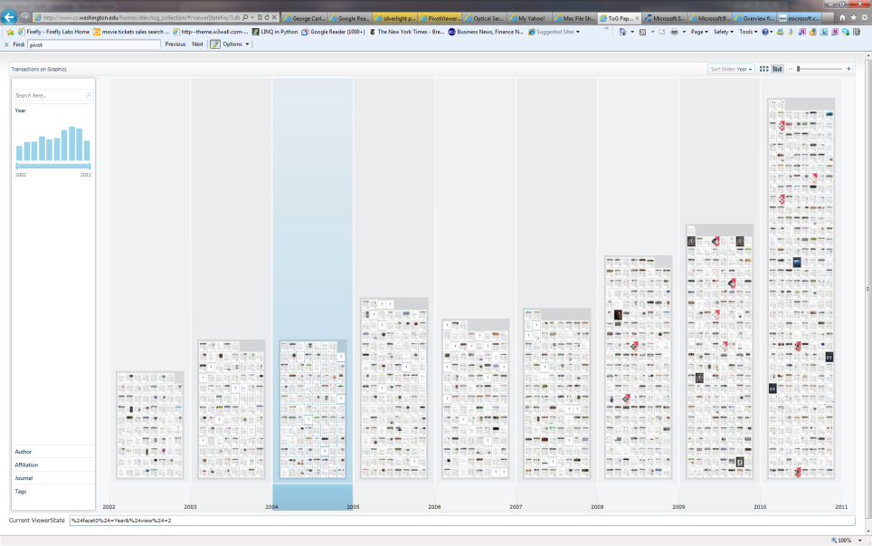
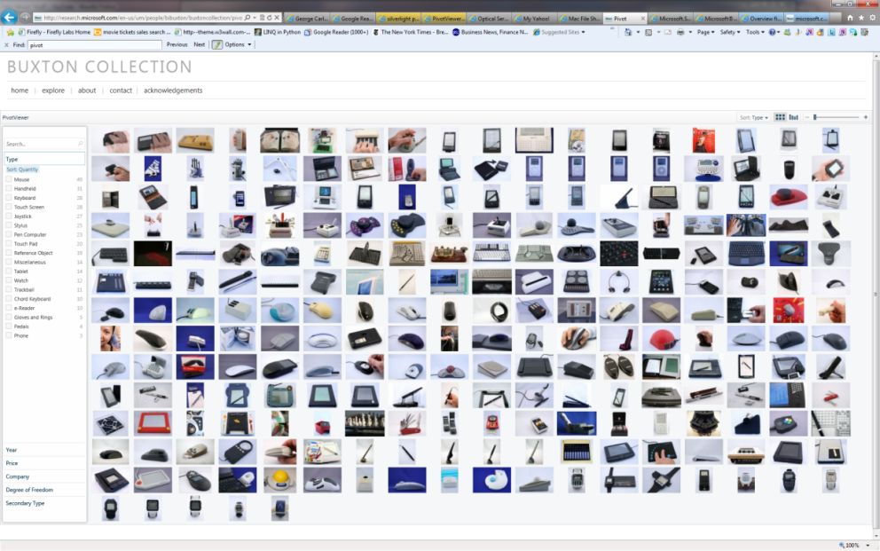
Scaling up number of thumbnails: LiveLabs Pivot
Daniel Leventhal
Bill Buxton
http://www.microsoft.com/silverlight/pivotviewer/

Slide 51
Similar ideas to previous faceted browser projects
Pros:
Built in multiresolution representation to allow smooth zooming
Standardized file format to allow anybody to create a representation
If someone wants to build intelligent feature extraction from items, they can, but it’s a separate process
Cons:
Can only deal with 6 columns in column layout (then starts aggregating)
Can only have one representation per item
Only two types of layout (histogram and grid)
Small cards Meaningless at overview levels
No position constancy (hard to refind items)

Slide 52
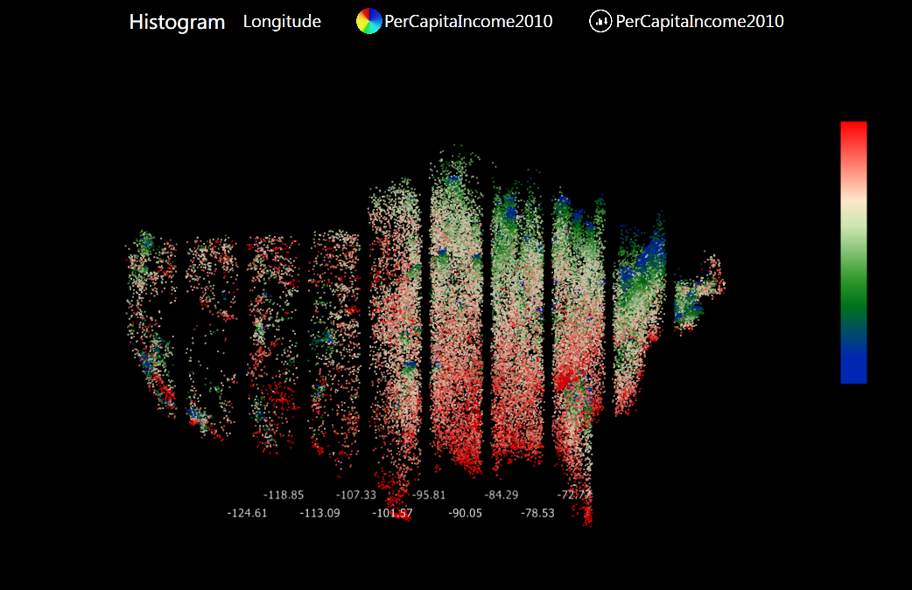
SandDance: scaling up (to 50000)

Slide 53
SandDance
Use layout, filtering and motion to reveal patterns
Multiple linked views of data
Filter based on any selection
GPU based acceleration to get interactive performance

Slide 54
Technical Notes
Implemented using WebGL
General purpose datavis library that scales to 50K-100K points (maybe higher)
Collaborative analysis supported

Slide 55
TimeQuilt (Huynh et al. 2005)
Huynh, D., Drucker, S., Baudisch, P., Wong, C.
Time Quilt: Scaling up Zoomable Photo Browsers for Large, Unstructured Photo Collections. CHI 2005. Portland, OR. Apr. 2005

Slide 56

Extract Features (Date/Time)

Slide 57
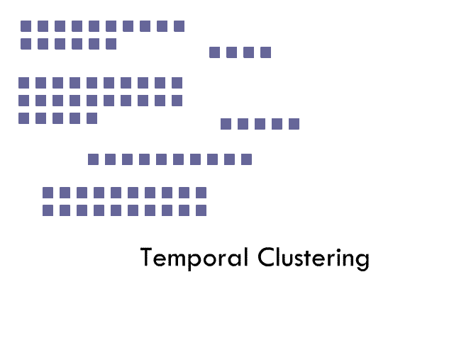
Calculate distances and cluster

Slide 58
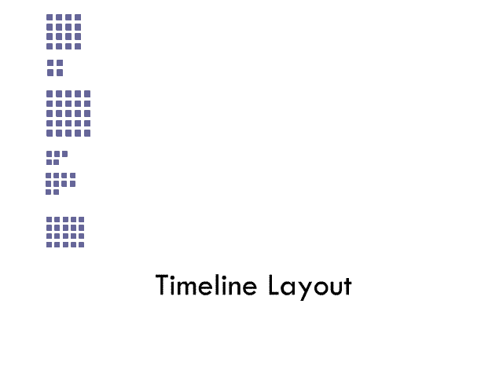
Relayout images in a timeline

Slide 59
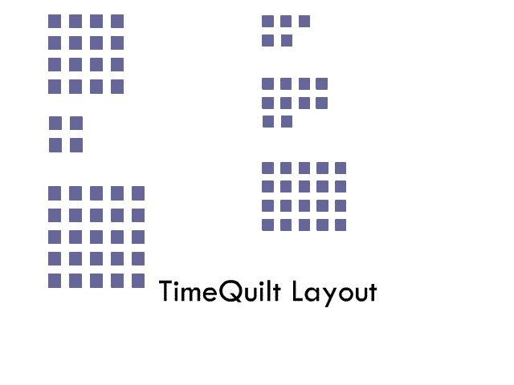
Re-layout images

Slide 60
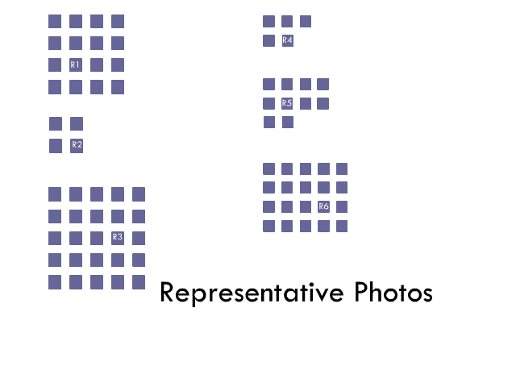
Find/choose representative images

Slide 61
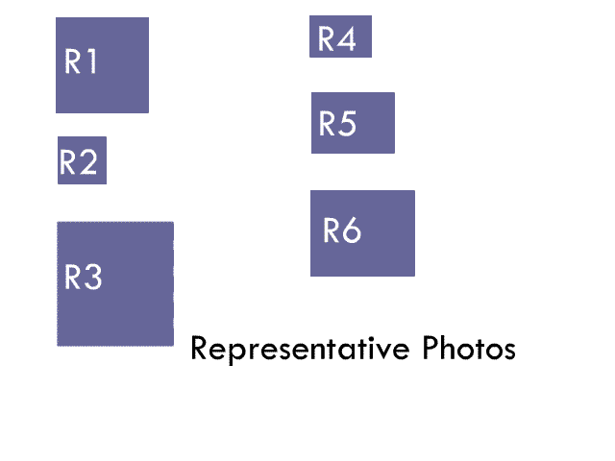
Relayout images (use representative photo)

Slide 62
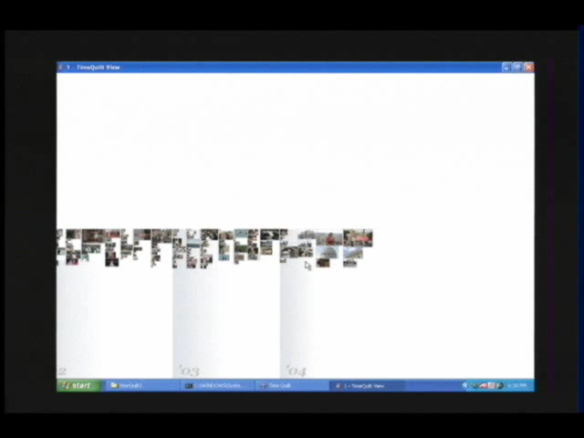
Video

Slide 63
Timequilt: lessons learned
Summaries (as we saw in visual snippets, websummaries) important
Position constancy was really useful for re-finding (if that’s your goal)
Can we use layout and clustering for input as opposed to just presentation

Slide 64
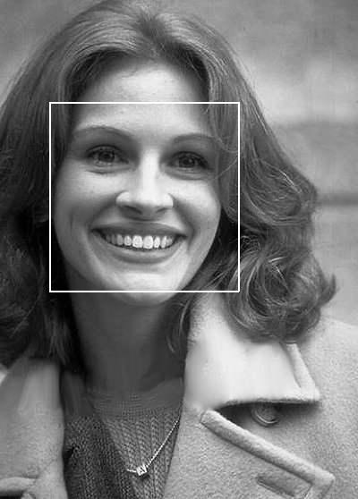
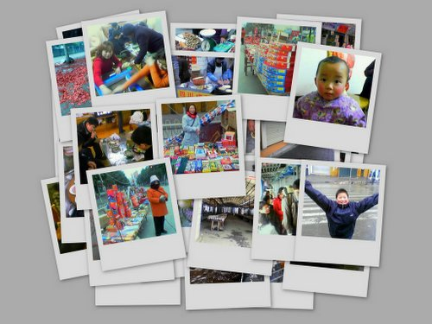
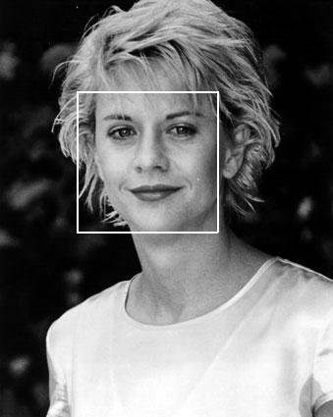
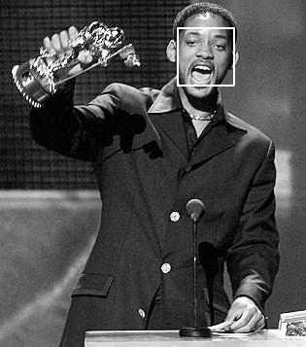
FaceSort:
Detect &
Extract Faces
Start with photos
64

Slide 65
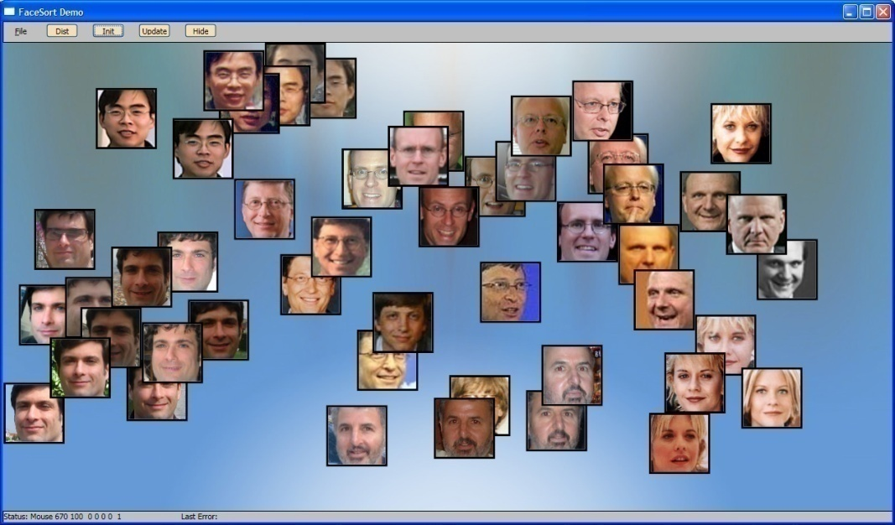
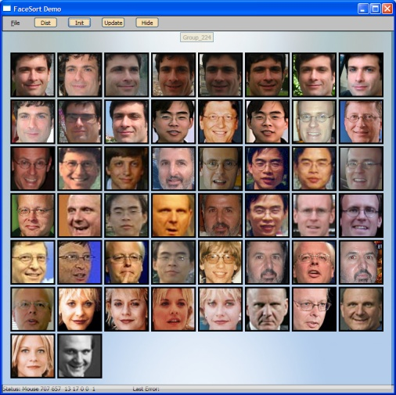
Basic FaceSort strategy
Use AI to cluster and order photos to make assignment to tags faster and easier than one by one manual assignment
Experimenting with 2 strategies:
2D layout to produce many distinct groups
1D layout to help segment clusters

Slide 66
FaceSort: Key Lessons
Clustering along different metadata, even inaccurate metadata can be helpful for labeling collections
Different strategies for dealing with clusters effective in different ways (1D and 2D)
Works only as well as the clustering works

Slide 67
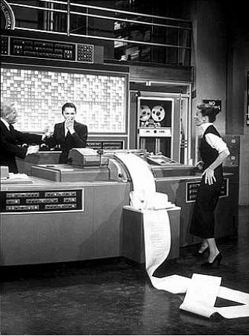
iClustering
Notes:
Machine learning friend of mine often gets requests to cluster documents, but that clustering rarely matches what people want as a cluster.

Slide 68
iClustering: Can we make better clusters?
Unsupervised machine learning not so great…
We want to learn what are the important features to the USER
From this, learn a metric distance
But people aren’t particularly good at introspecting on features
Old techniques for asking which pairs of documents go together.
Not particularly natural or sensible to the user

Slide 69
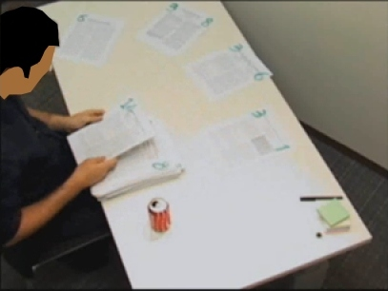
We propose a different strategy:
Observed how people behave when asked to do this task with real papers:

Slide 70
Find strategies and pain points where they have problems and support the strategies while eliminating the pain points
Use desktop as holding area
Pile papers into distinctive stacks, label the piles
User spatial memory to refind papers and stacks
Different organizational principles between people

Slide 71
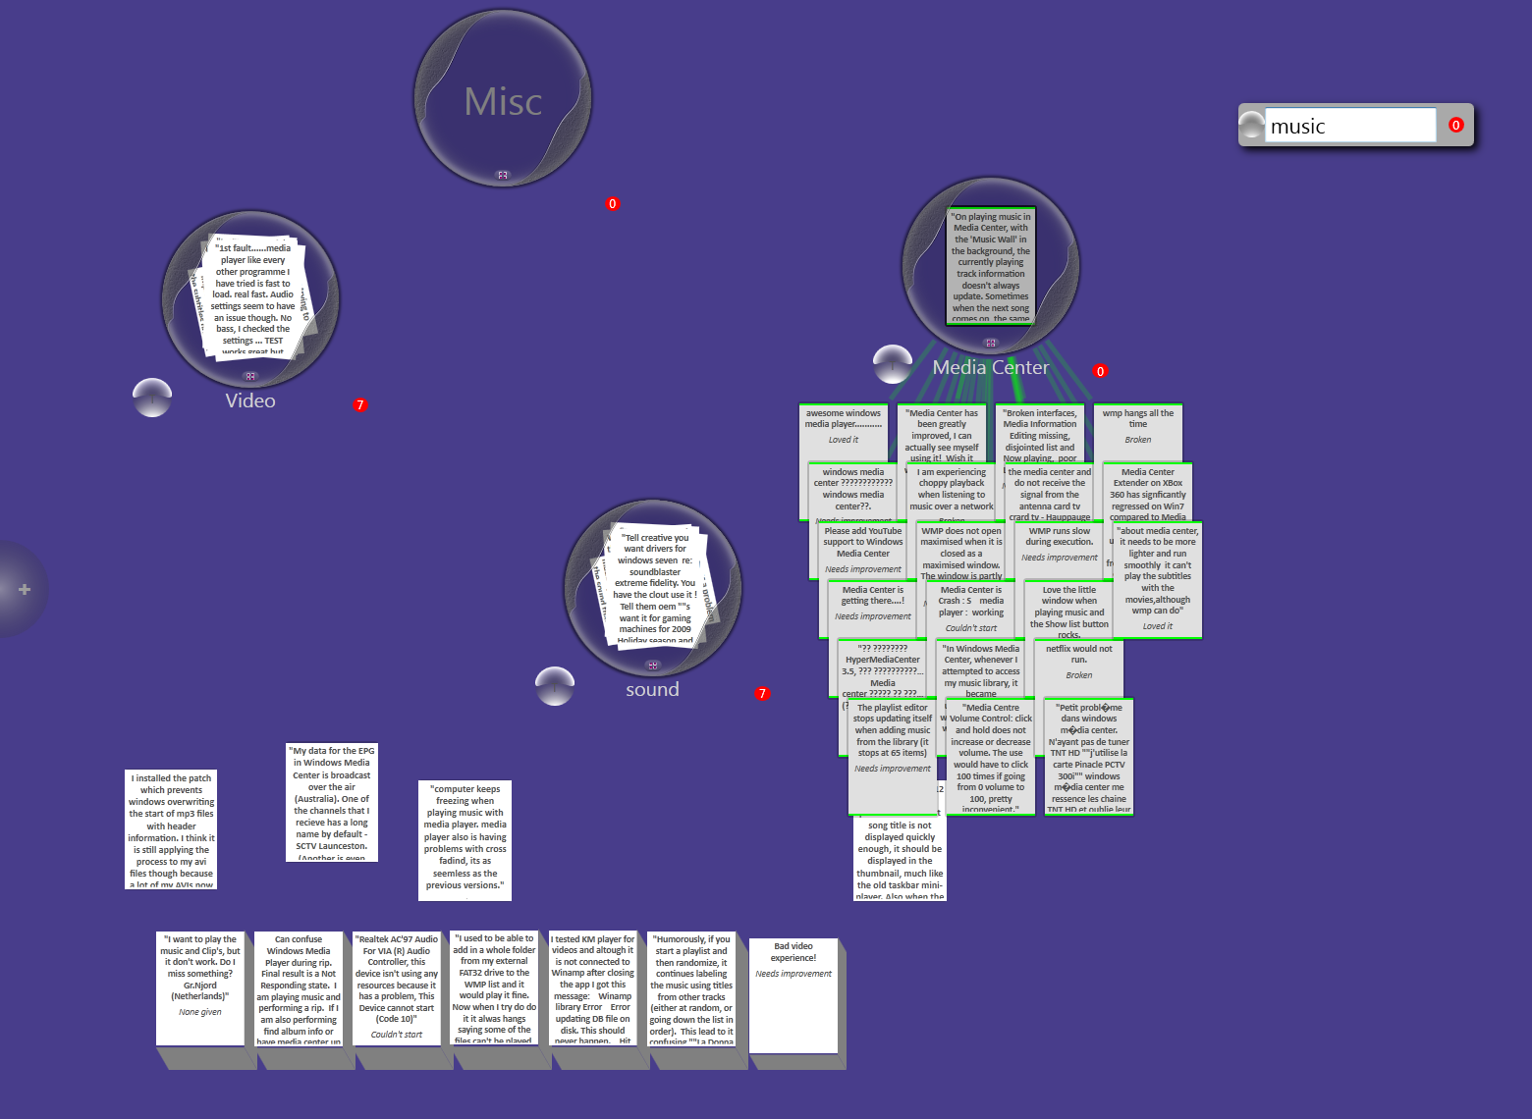
iCluster Prototype System

Slide 72
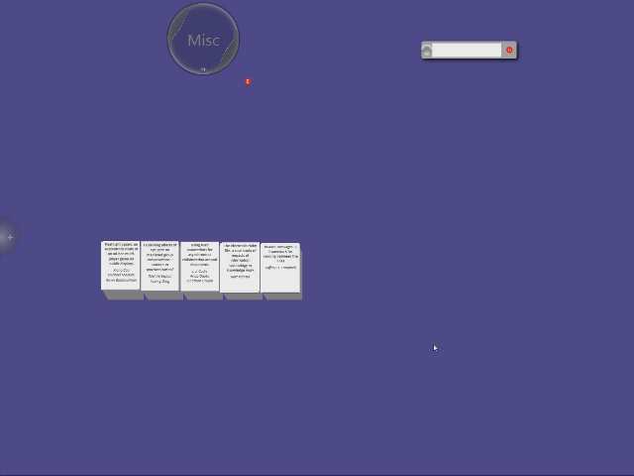
Video

Slide 73
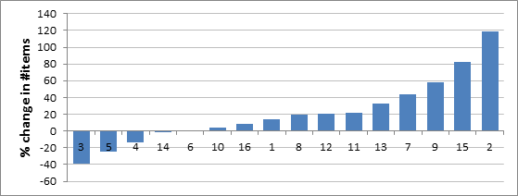
iClustering: Speedup

Slide 74

iClustering Quality

Slide 75

Alternate uses

Slide 76
Conclusions:
Extract
Summarize
Layout
Browse

Slide 77
Extract:
Extract
Summarize
Layout
Browse
MediaFrame: faces, time, indoor outdoor
Visual Snippets: Title, Logo, Primary Image,
WebSummaries: Guided extraction
FaceSort: visual features
iClustering: TF/IDF, Graph Features, Use Preferences

Slide 78
Summarize:
Extract
Summarize
Layout
Browse
Visual Snippets: adaptive layout of key features
WebSummaries: cards
TimeQuilt: Representative image
Often hand picked (some great work by Ranjitha Kumar & Scott Klemmer on transferring designs)

Slide 79
Layout
Extract
Summarize
Layout
Browse
MediaFrame: Cluster or full layout
TimeQuilt: Cluster, but keep position constant
WebSummaries: User templates for time, place, index
FaceSort: MDS
iClustering: Clusters

Slide 80
Browse
Extract
Summarize
Layout
Browse
MediaFrame: Faceted filtering, zoom, details on demand
TimeQuilt: zoom
WebSummaries: Templates for browsing time, place, w/ filtering
iClustering: Desktop Metaphor
Pivot: Faceted filtering
Show relationships: (brushing, explicit lines)

Slide 81
Final thoughts:
User Interface is less of a ‘science’ and more like a craft. e.g. architecture:
Creative/Design discipline, but with principles
Need to design/build/test/iterate
Managing complexity involves finding ways to extract essential features and using those features to represent the important information, adjust the layout and interaction
Thanks to all interns and collaborators
Especially Mira Dontcheva, David Huynh, Chang Hu, Hao Lu, Kayur Patel, Michael Toomim
http://research.microsoft.com/~sdrucker

Slide 82
Project Map
Home Page
(exhibit)
Mediaframe
Pivot
generalize
Larger Numbers
Vikis
(ThumbTack)
Triage
webpages
Phototriage
WebSpace
PixAura
TimeQuilt
WebSummaries
Better Summaries
Visual Snippets
Clustering + ML
Clips, Cards,
Relations
FaceSort
FacetPatch
Reform
iCluster

